Slide 1
MICHELANGELO
(1475-1564)
History of Western Art
BFA-II (Visual Arts)
Course Incharge: Ms. Farah Khan
Institute of Design & Visual Arts (LCWU)

Slide 2
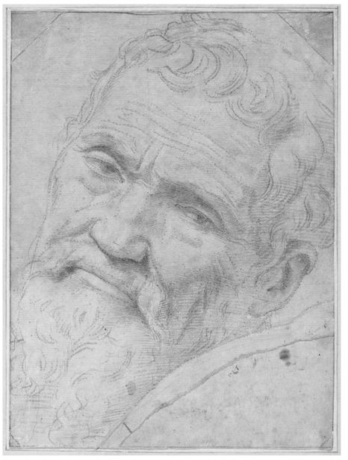
Self Portrait by the artist (1540’s)

Slide 3
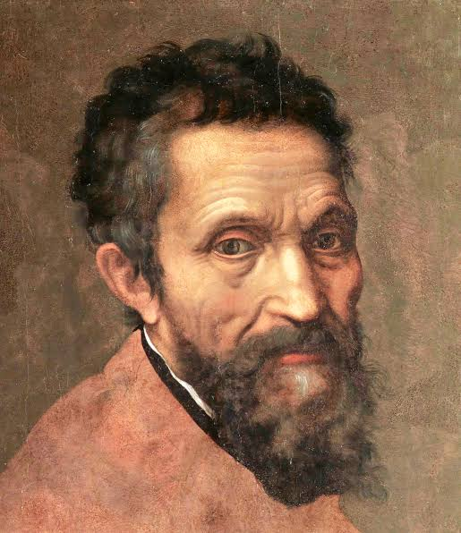
Self Portrait by the artist

Slide 4
He expresses all that the art of painting can make of the human body, leaving out no gesture or movement
(Ascanio Condivi)

Slide 5
MICHELANGELO (1475-1564)
Michelangelo was without doubt one of the most inspirational and talented artists in modern history.
During his life, the western world underwent what was perhaps the most remarkable period of change since the decline of the Roman Empire. The Renaissance saw changes in all aspects of life and culture, with dramatic reforms sweeping through the worlds of religion, politics, and scientific belief.
Michelangelo was one of the most fervent advocates of this exciting new philosophy, working with a remarkable energy that was mirrored by contemporary society. One of the leading lights of the Italian Renaissance, his extraordinary talents emerged in early works such as the Pieta for the Vatican, and the statue of David commissioned for the city of Florence. His paintings and frescoes were largely taken from mythological and classical sources.
He manage to combine his high level of technical competence and his rich artistic imagination to produce the perfect High-Renaissance blend of aesthetic harmony and anatomical accuracy in his works.
Michelangelo was born on March 6, 1475 in Caprese near Arezzo, Tuscany. He was the first artist who was recognized during his life time. He is also the first western artist whose biography was published when he was still alive. Two biographies for him was written, one was by Giorgio Vasari, who praised Michelangelo as the greatest artist since the beginning of renaissance.

Slide 6
MICHELANGELO (1475-1564)
He is the best documented artist in 16th Century and has influenced so many areas of art development in the West. Together with Leonardo Da Vinci, the two stood out as strong and mighty-personalities with two irreconcilably opposed attitudes to art, yet with a bond of deep understanding between them.
His father was a governor of Caprese before returning to Florence. At the age of 6, Michelangelo was sent to a Florence grammar school as his father planned a political and diplomatic career for his son but he showed no interest in schooling. He would rather watch the painters at nearby churches, and draw what he saw there. Following his interest in drawing, he covered the walls of his house with charcoal drawings. His father realized he had no interest in family's financial business and agreed to send him to the painter Ghirlandaio to be trained as an apprentice. He was 13 years old at time. In this fashionable Florentine painter’s famous workshop, Michelangelo learned the technique of Fresco painting and draftsmanship.
Michelangelo spent only a year at the workshop and understood that he could benefit more from studying the early Florentine masters Giotto and Masaccio. He made copies of their style and analyzed their style as can be seen in his early works. Then he moved into the palace of Florentine ruler Lorenzo the Magnificent, of the powerful Medici family, to study classical sculpture in the Medici gardens. He was only 15 to be chosen at the ‘school of the garden of Lorenzo’. It was not a school in the true sense, but a liberal academy of artists, humanists and poets, all great lovers of antiquity.

Slide 7
MICHELANGELO (1475-1564)
He studied under famous sculptor Bertoldo di Giovanni there and exposed himself to many of the great artists of past centuries, Giotto, Masaccio, Donatello, as well as the masterpiece antiquities of ancient Greece and Rome: works that were held in Medici’s vast collection. He also met many living artists, philosophers, writers and thinkers of the day, including Poliziano, Marsilio Ficino and Pico della Mirandola. It was while he was with the Medicis that Michelangelo completed his first two commissions as a sculptor: marble reliefs, Madonna of the Stairs, and Battle of the Centaurs. Both amazingly sophisticated and complex works for a teenager. Michelangelo became, during this time, an expert in portraying the human form, drawing from life and studying anatomy. He also obtained special permission from the Catholic Church to study human corpses to learn anatomy, though exposure to corpses had worsened his health condition.
After the death of Lorenzo de Medici, Michelangelo left the Court and, soon after, the arrival of Savonarola and the expulsion of the Medicis from Florence brought huge change for the young artist. After a short return to his father’s house, Michelangelo left Florence during the political upheaval and, maintaining his links to his patrons, the Medicis, he followed them to Venice, then on to Bologna.
In Bologna, Michelangelo continued his work as a sculptor. He carved three statues for the Shrine of St. Dominic, an angel with a candlestick and saints, Petronius and Proculus.

Slide 8
MICHELANGELO (1475-1564)
Continuing to be heavily influenced and inspired by classical antiquities, Michelangelo also became involved in a scheme to pass off one of his sculptures, a marble cupid, as an ancient work. By all accounts, he was told by Lorenzo di Pierfrancesco de Medici to make it look as though it had been dug up, so he could sell it in Rome. Cardinal Raffaele Riario, who bought the piece, discovered the deception, but was so impressed by the quality of the sculpture that he invited the artist to Rome.
Michelangelo arrived in Rome in 1496 when he was 21 years old. It was while in Rome, in his early twenties, that Michelangelo sculpted Pieta, now in St. Peters in the Vatican, in which the Virgin Mary weeps over the body of Jesus. Michelangelo went to the marble quarry and selected the marble for this exquisite piece himself. It was frequently said that Michelangelo could visualize the finished sculpture just be gazing at a block of stone. This sculpture showed his mastery of anatomy and ability to make marble drapery look like the softest of cloth.
He was now a man at the height of his creative powers, and, in 1504, back in Florence, he completed his most famous sculpture, David. David, depicted at the moment he decides to battle Goliath, was a symbol of Florentine freedom. It is said to be a masterpiece of line and form. A committee, including Leonardo da Vinci and Sandro Botticelli, was created and decided on its placement, in front of the Palazzo Vecchio.

Slide 9
MICHELANGELO (1475-1564)
Michelangelo accepted many commissions, sculptures and paintings during his time in Florence, many of which went unfinished when, in 1505, he was called back to Rome to work on a Tomb for Pope Julius II. It was planned to be finished within 5 years but he worked on it (with frequent interruptions) for over forty years, and it seems it was never finished to his satisfaction. Fortunately, Michelangelo also completed some of his best, and most well-known work, during this time, most notably the fresco on the ceiling of the Sistine Chapel, which took him four years to finish.
This grand fresco contains over three hundred figures over five hundred square meters of ceiling. It took Michelangelo four years, lying on his back, to complete this masterful work, which stands even today as a testament to this one man’s dedicated and accomplished artistry. The scenes depicted are from the Book of Genesis, the most famous of which is The Creation of Adam. The outstretched hands of God and Adam are an iconic image, perhaps the most widely known and imitated detail from any renaissance piece. Michelangelo, in this work, demonstrated his deep understanding of the human form, and how to depict it in a huge array of different poses.
He covered the immense curved ceiling and divided the area of the ceiling boldly into panels of painted architectural cornices and moldings that had a double purpose. First, it was to tell the story of the beginnings of the world, of Adam and Eve, the Fall, the Expulsion and the Flood. Secondly, it was to glorify man as a creature of infinite nobility, beauty and power.

Slide 10
MICHELANGELO (1475-1564)
Michelangelo while executing this project of Sistine Chapel suffered with great physical discomfort while painting the ceiling. In a letter to his family he wrote
‘Here I am with so many worries and physical worn out, and I have absolutely no friends at all, nor do I want any, and there isn’t even time to eat’
But by the time he had completed the work, Michelangelo was universally regarded as the greatest living artist, and this happened during the lifetime of two other giants of the period, Leonardo da Vinci and Raphael
The complex, twisting figures and vibrant colors of this work, and the sculptures with their writhing forms, played a huge role in the birthing of an entire artistic movement.
Mannerism, largely derived from the work of Michelangelo, is a deliberately stylized form of sophisticated art, in which the human body is idealized. It can be characterized by often complex, and sometimes witty, composition and unnatural use of vibrant colors. Without Michelangelo, the works of later Mannerist artists like, for example, Pontormo and Bronzino, would not exist. Raphael was also strongly influenced by Michelangelo, as were later ceiling painters in the Baroque period, and many others since.
His influence on art over the past centuries cannot be estimated. He is rightly viewed as a genius, and as the archetypal Renaissance man.

Slide 11
MICHELANGELO (1475-1564)
Michelangelo also decorated the Medici tombs of Lorenzo de Medici and Giuliano with sculptures. The figures of the two men are flanked by four semi-reclining figures, powerful expressionist interpretations of Day and Night, Dawn and Dusk. These symbols of time and mortality are among his finest creations.
In 1534, Pope Clement VII gave Michelangelo another colossal commission to decorate the altar wall of the Sistine Chapel. In the prevailing political and religious turmoil, he chose the subject of Last Judgement. In this phase, he was going through a spiritual and religious crisis, it has been said that the overall painting is a terrifying vision of his own suffering. The central theme is the drama of human life, man’s destiny to be ever further from God, sinful yet meant for eventual salvation. Michelangelo’s mastery in painting the altar-piece left both cleric and layman speechless with wonder.
Acclaim for the Judgement rings in my ears: I think that because of its beauty, the day when Christ comes in glory, He will have to insist that all take these attitudes, show this beauty, and that Hell keeps the darkness that you have painted, for fear of being able to do no better…
Letter from A. Doni to Michelangelo

Slide 12
MICHELANGELO: An influential artist that left long lasting effect
Michelangelo’s art has far reaching historic influence. His world is genetically a two-fold system continually expanding. Measuring his internal development from the Pieta through David to The Last Judgement, we view the path of an experience in which each stage provides the foundation for the next, from sculpture to painting, painting to architecture, architecture to the art of poetry. How can we not be moved by this will, anxious to express the new by using traditional means? At the same time we are aware of the power of his influence. First mannerism, then Johannes Vermeer, Rembrandt, Eugene Delacroix, Rodin, Pollock and De Kooning found in him a model on which they could base their own creations. But the ‘divine’ Michelangelo is more than that. In western world, he was the first - Picasso the last - to regard himself as an absolute and mythic cultural experience. He managed to combine his high level of technical competence and his rich artistic imagination to produce the perfect High Renaissance blend of aesthetic harmony and anatomical accuracy in his work.
Michelangelo dominated his time, the Renaissance. He is part of its myth. Like all mythic creation, he appears with same vigor, the same impact, the mystery of origins, the comprehension of the moment and the interpretation of final endings. It is hard to imagine a more attentive and ambitious creation on these three points united by the energy of the most universal expression possible of that fulfillment we call destiny.

Slide 13
MICHELANGELO: An influential artist that left long lasting effect
Just like William Shakespeare on literature, and Sigmund Freud on psychology, Michelangelo's impact on art is tremendous. Michelangelo not only outshines all his predecessors; he remains the only great sculptor of the Renaissance at its best. What most Late Renaissance artists lacked was not talent but the ability to use their own eyes and share a vision with either their contemporaries or posterity. Michelangelo’s extreme genius left little scope for works that escaped his influence, damning all his contemporaries to settle for aping him. Appreciation of Michelangelo’s artistic mastery has endured for centuries, and his name has become synonymous with the best of the Renaissance Art.

Slide 14
Quotes by Michelangelo
I saw the angel in the marble and carved until I set him free.
Every block of stone has a statue inside it and it is the task of the sculptor to discover it.
The true work of art is but a shadow of the divine perfection.
It is necessary to keep one's compass in one's eyes and not in the hand, for the hands execute, but the eye judges.
Good painting is the kind that looks like sculpture
If people knew how hard I had to work to gain my mastery, it would not seem so wonderful at all.
The greatest danger for most of us is not that our aim is too high and we miss it, but that it is too low and we reach it.
The greater danger for most of us lies not in setting our aim too high and falling short; but in setting our aim too low, and achieving our mark.
Genius is eternal patience.
A man paints with his brains and not with his hands.
Lord, grant that I may always desire more than I can accomplish.

Slide 15
Sculptures

Slide 16
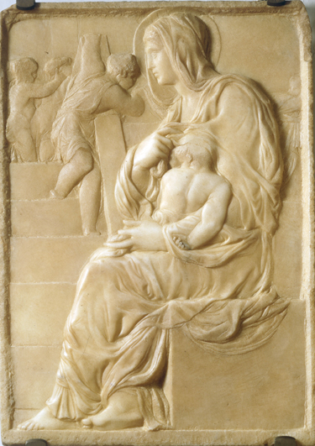
Madonna of the Chairs (1491)

Slide 17
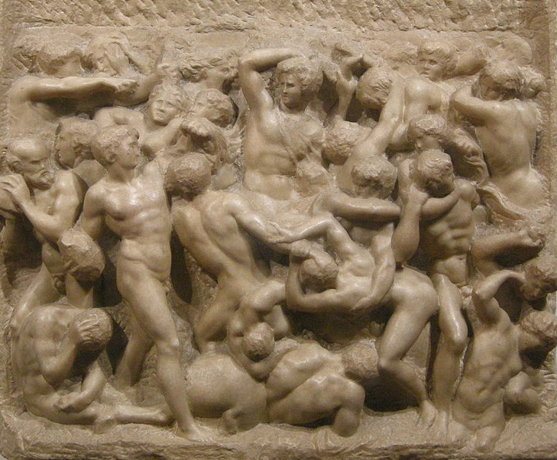
Battle of the Centaurs (1492)

Slide 18
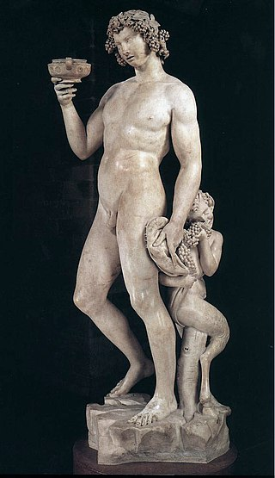
Bacchus (1496-97)

Slide 19
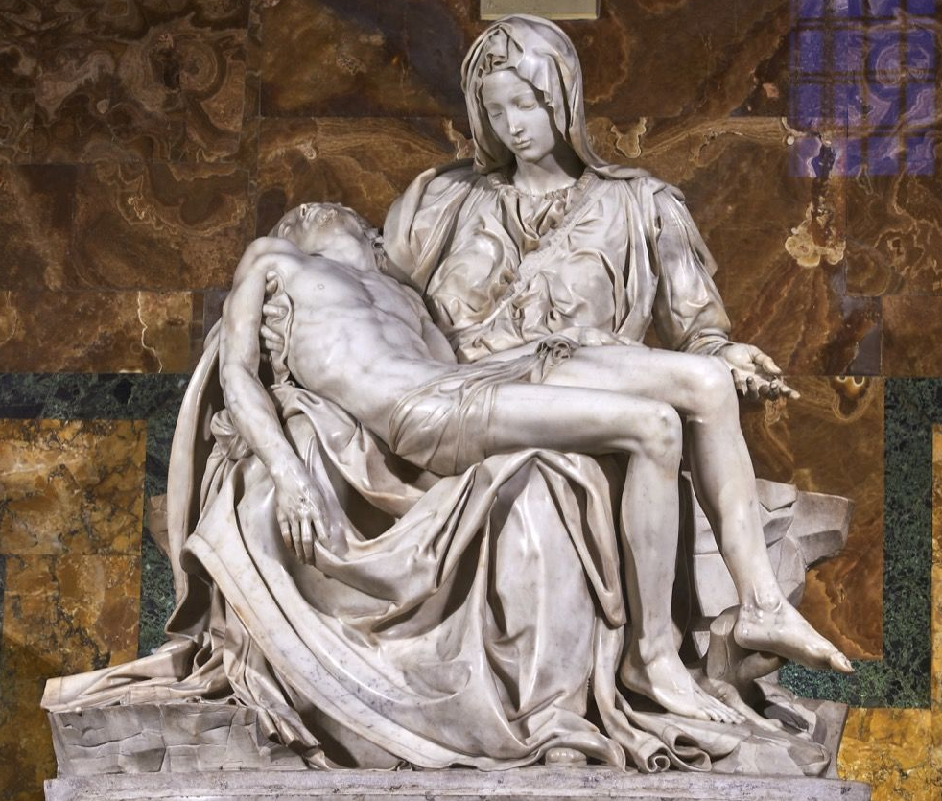
Pieta

Slide 20
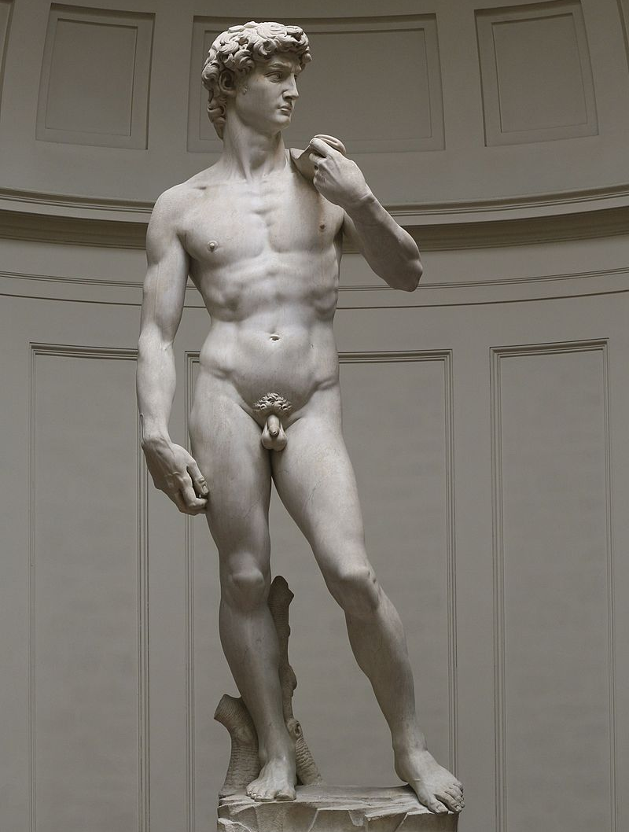
David (1501-1504)

Slide 21
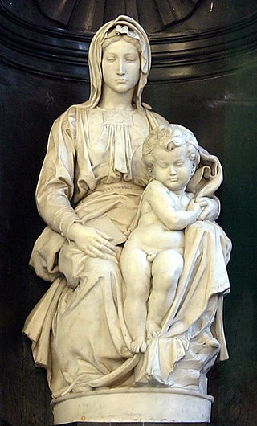
Madonna and Child (1501-1504)

Slide 22
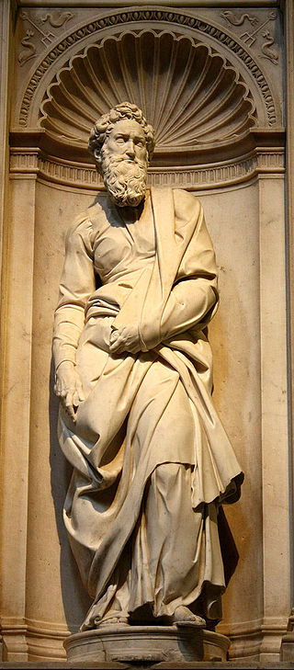
St. Paul (1503-1504)

Slide 23
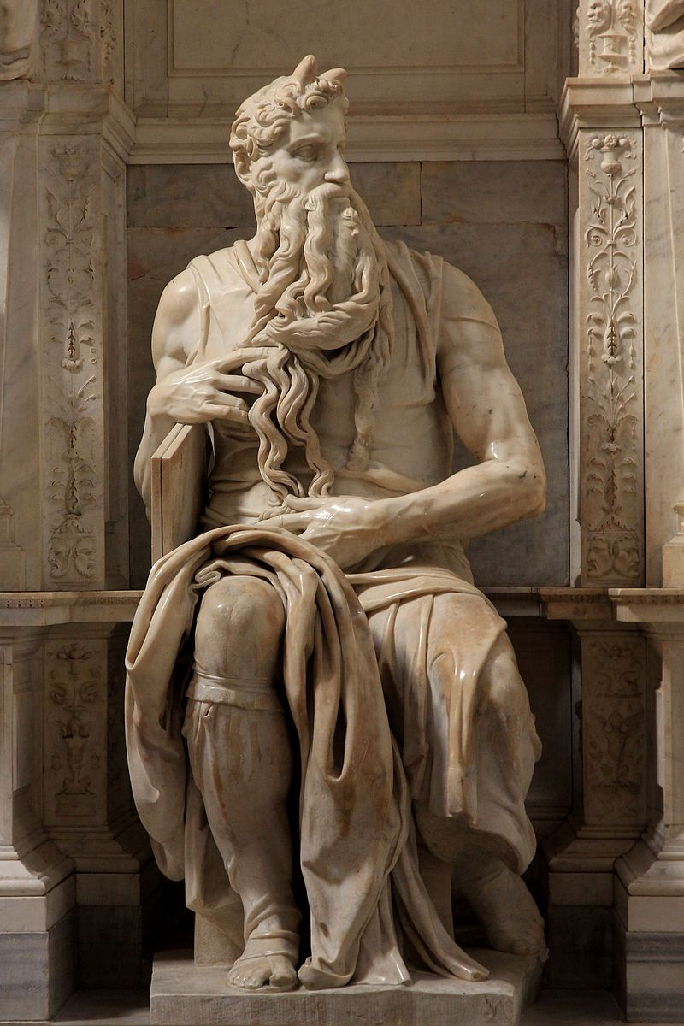
Moses (1513-1515)

Slide 24
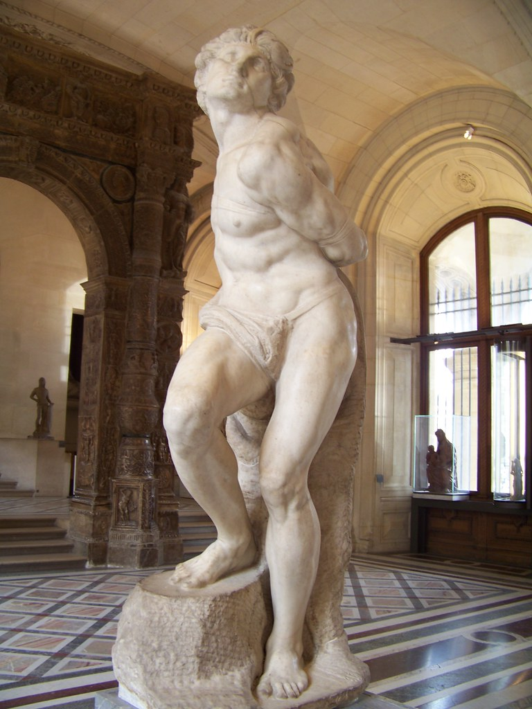
Rebellious Slave (1513-1516)

Slide 25
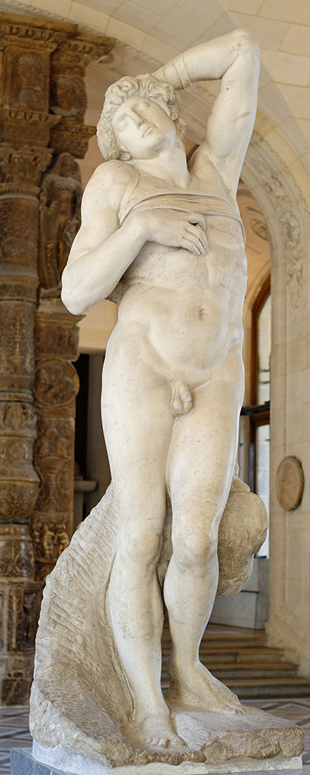
Dying Slave (1513-1516)

Slide 26
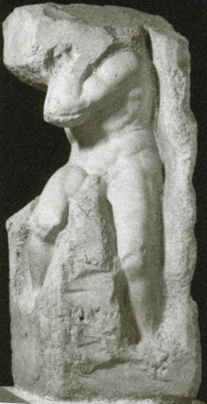
Atlas Slave (1520-1523)

Slide 27
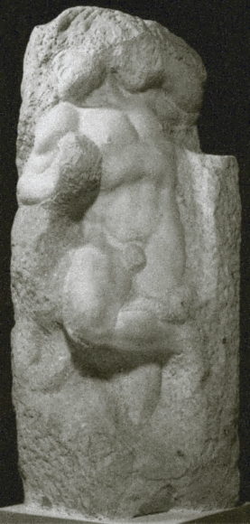
Awakening Slave (1520-1523)

Slide 28
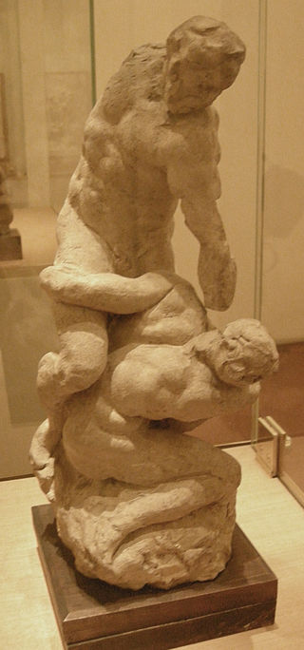
Scale model for Two Fighters (c.1530’s)

Slide 29
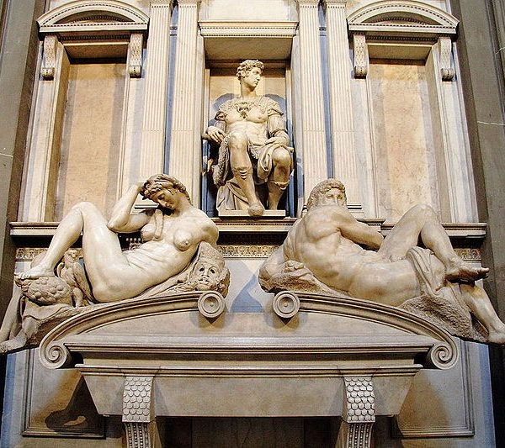
Day and Night (1524-1534)

Slide 30
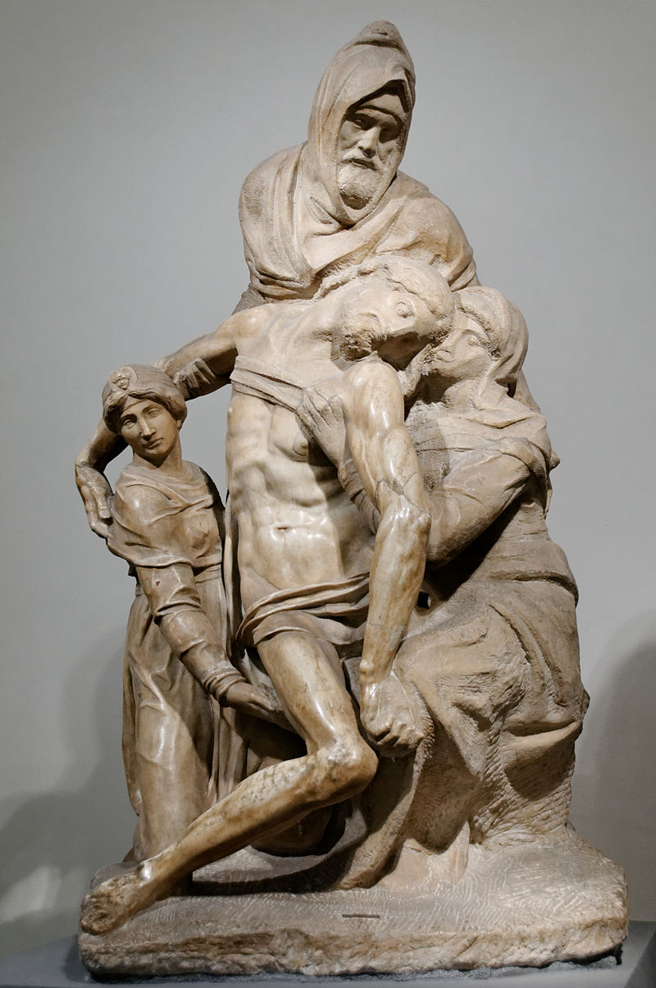
Atlas Slave (1547-1553)

Slide 31
Paintings

Slide 32
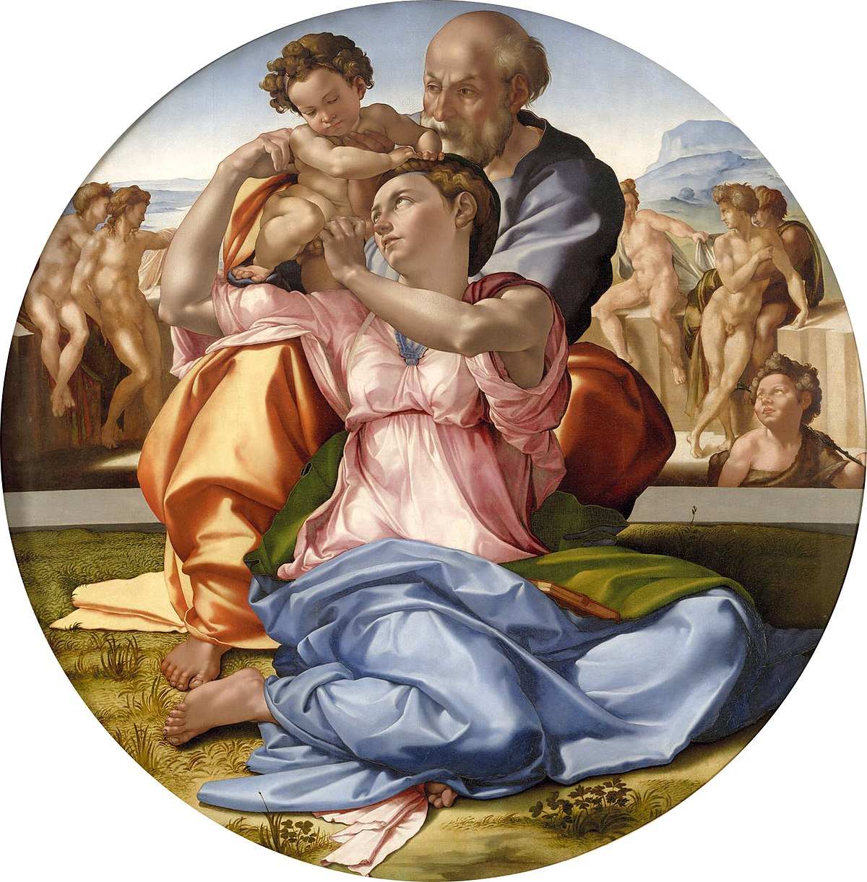
Holy Family with St. John

Slide 33
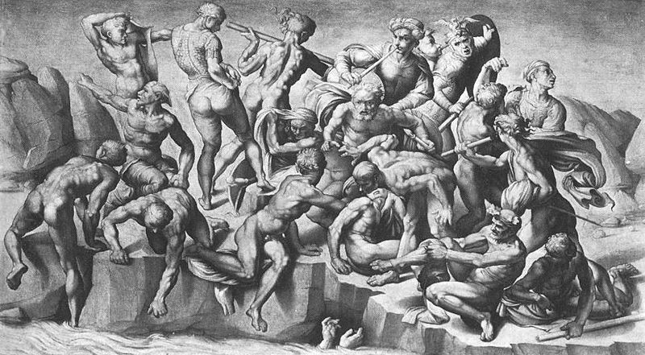
The Battle of Cascina (1504)

Slide 34
Ceiling of Sistine Chapel (1508-1512)

Slide 35
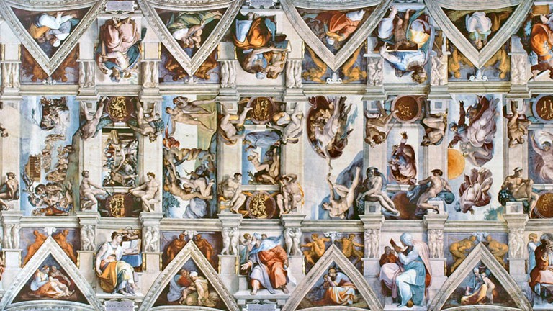
The Ceiling of Sistine Chapel (1508-1512)

Slide 36
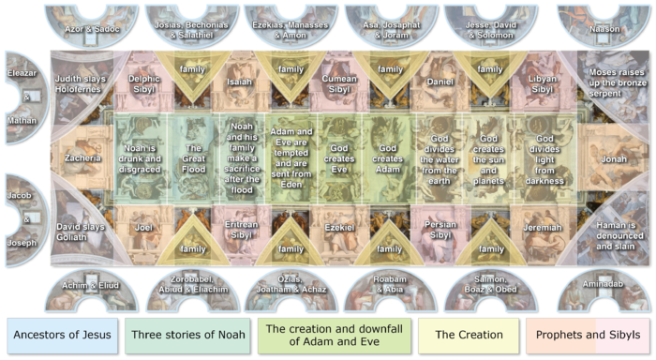
Division of subjects on the Ceiling of Sistine Chapel

Slide 37
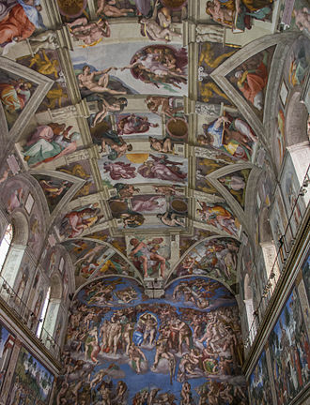
The Ceiling of Sistine Chapel

Slide 38
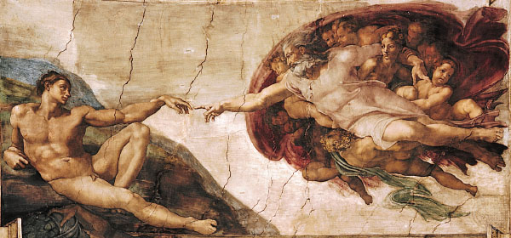
The Creation of Adam

Slide 39
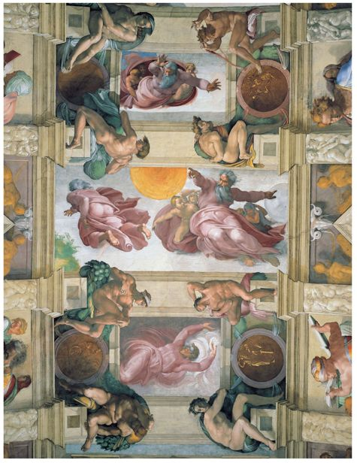

Slide 40
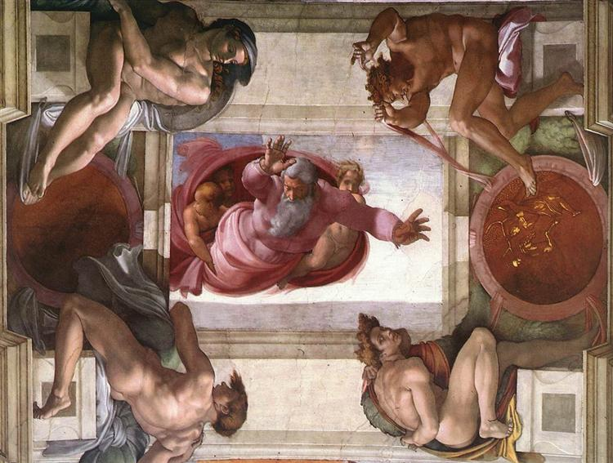
The creation of life in the water

Slide 41
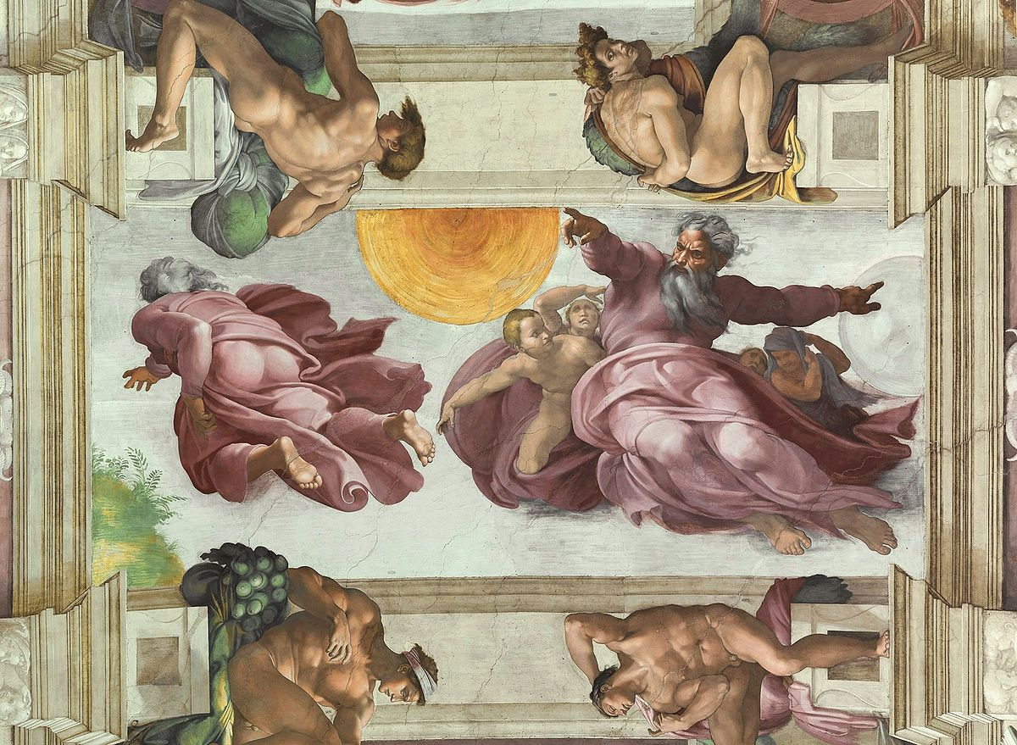
Creation of the Sun and Moon

Slide 42
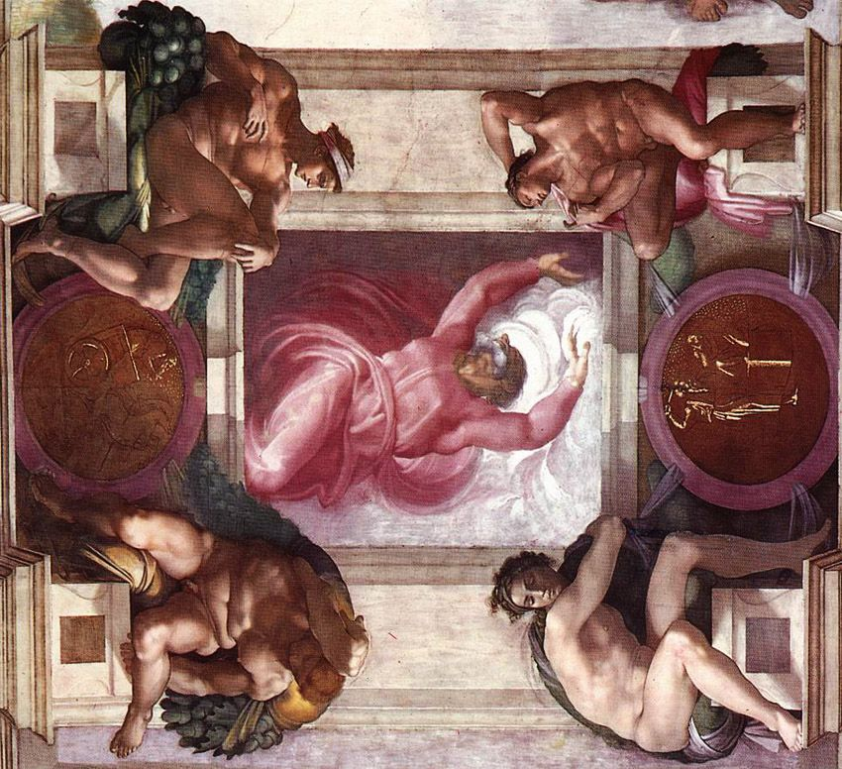
Separation of light and darkness

Slide 43
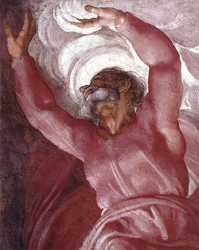
Close-up study of the same

Slide 44
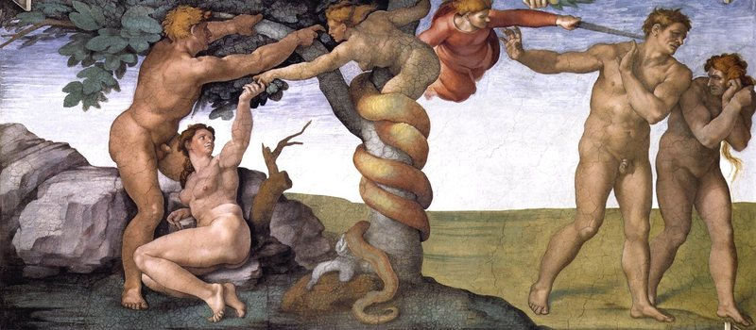
Expulsion of Adam and Eve

Slide 45
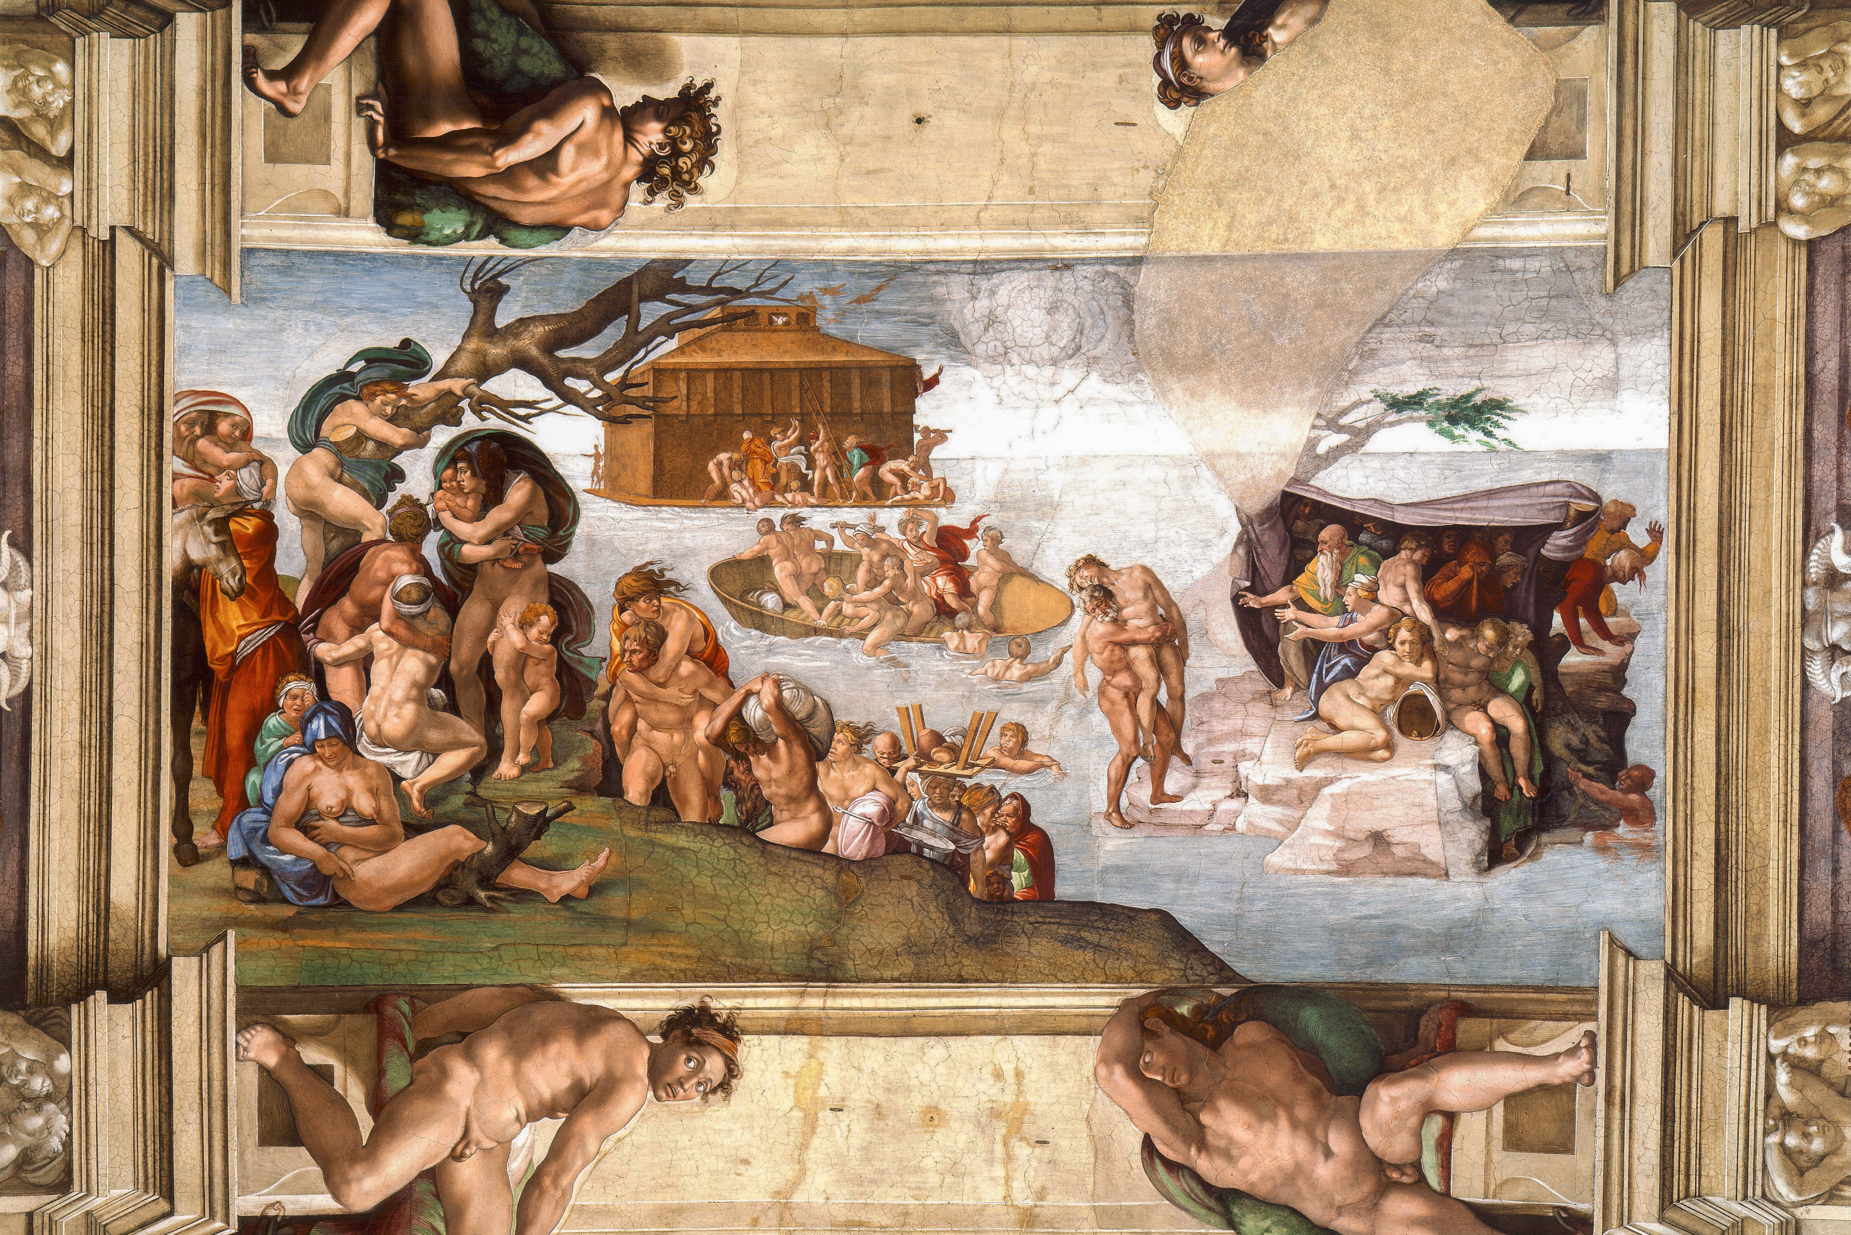
The Deluge

Slide 46
Details of The Deluge

Slide 47
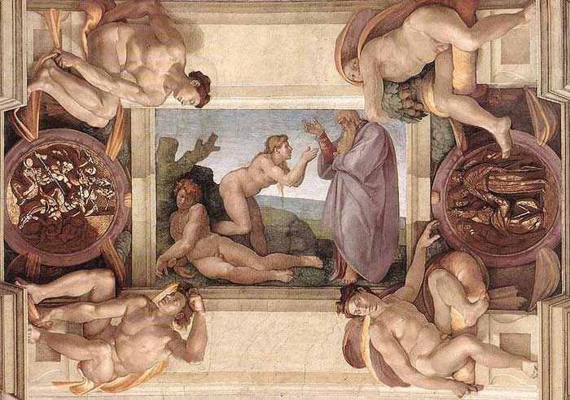
Creation of Eve

Slide 48
The Deluge

Slide 49
The Deluge

Slide 50
The work has proved a veritable beacon to our art, of inestimable benefit to all painters, restoring light to a world that for centuries had been plunged into darkness. Indeed, painters no longer need to seek for new inventions, novel attitudes, clothed figures, fresh ways of expression, different arrangements, or sublime subjects, for this work contains every perfection possible under those headings
(Vasari)

Slide 51
The Last Judgement (1534-1541)

Slide 52
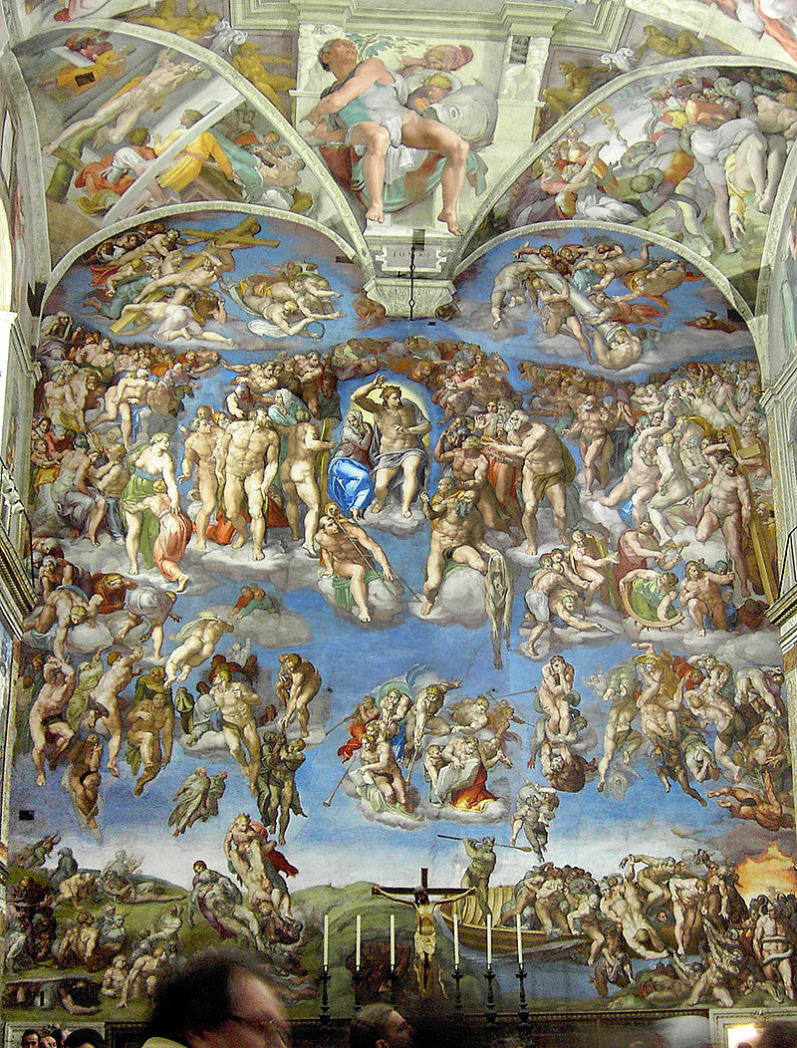
The Last Judgement (1534-1551)

Slide 53
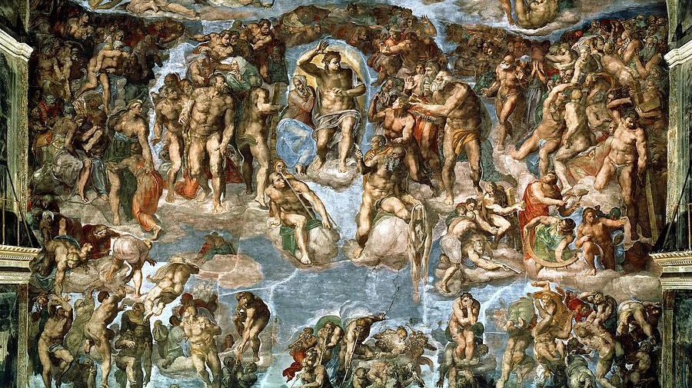
The Last Judgement (1534-1551)

Slide 54
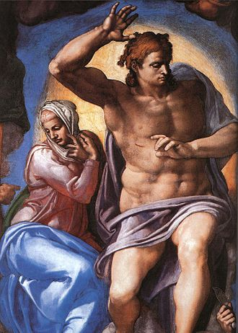
Mary and Christ from the Last Judgement (1534-1551)

Slide 55
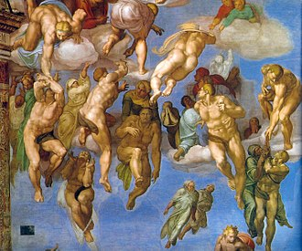
The Last Judgement (1534-1551)

Slide 56
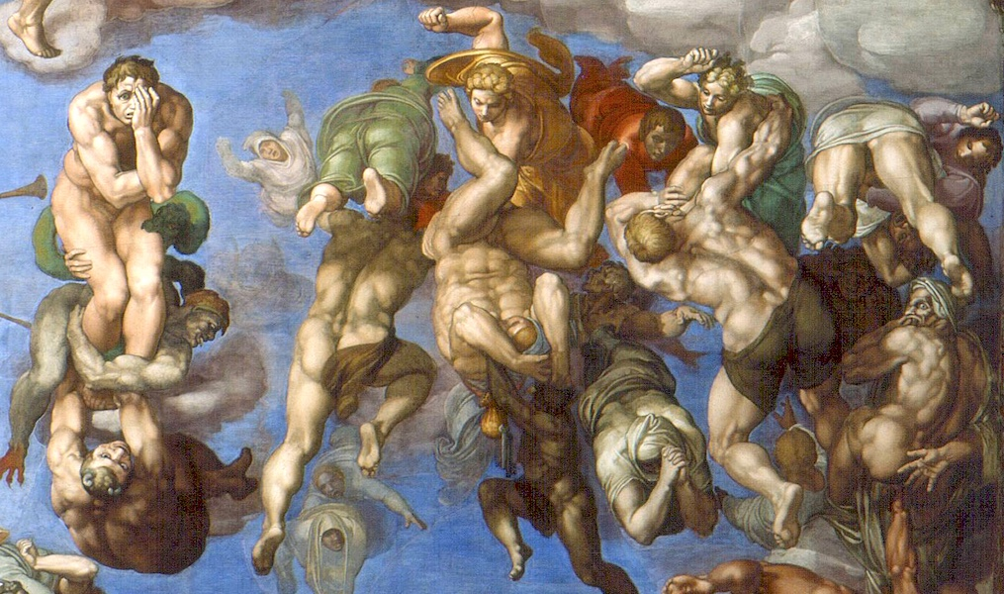
The Last Judgement (1534-1551)

Slide 57
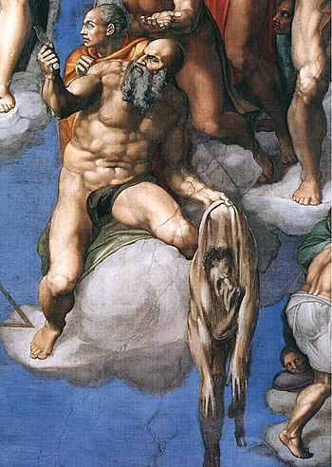
The Last Judgement (1534-1551)

Slide 58
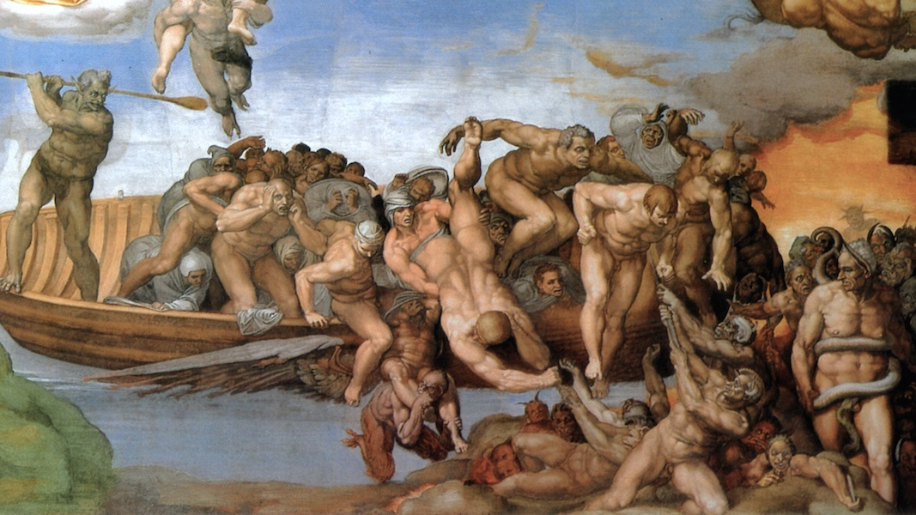
The Last Judgement (1534-1551)

Slide 59
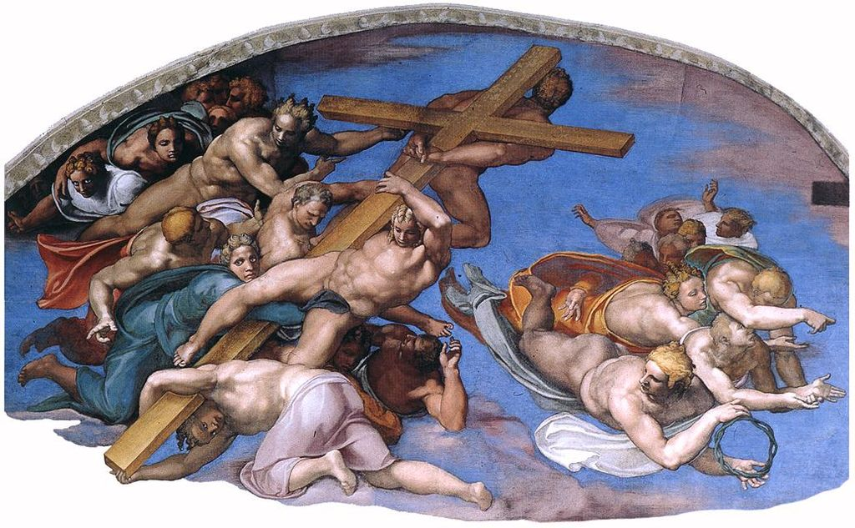
The Last Judgement (1534-1551)

Slide 60
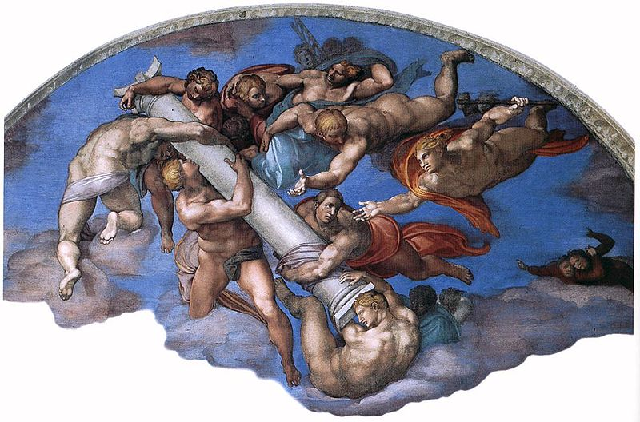
The Last Judgement (1534-1551)

